Slide 1


CMR TECHNICAL CAMPUS
UGC AUTONOMOUS
Accredited by NAAC with A Grade
Approved by AICTE, New Delhi and Affiliated to JNTUH, HYDERABAD
Kandlakoya (V), Medchal Road, Hyderabad -501401,Telangana
Department of Computer Science and Engineering
Mini Project Review-03
SOCIAL MEDIA AND MISLEADING INFORMATION IN A DEMOCRACY
A MECHANISM DESIGN APPROACH
BATCH NO-12
C.HEMA BINDU(207R1A05D4)
KAREMI TEJA (207R1A05E7)
CH NAVATEJ (207R1A05D2)
PRESENTED BY:
UNDER THE GUIDANCE OF:
K.SHILPA
(ASSISTANT PROFESSOR)

Slide 2
CONTENTS:
Abstract
Existing system
Disadvantages of Existing system
Proposed system
Advantages of Proposed system
Hardware requirements and Software reqiremets
Novelty of the Project
Architecture
Modules
UML Diagrams
Sample code
Results
Test Cases
Future Scpoe
References
Conclusion

Slide 3
ABSTRACT:
In this project, we present a resource allocation mechanism to incentivize misinformation filtering among strategic social media platforms and, thus, to indirectly prevent the spread of fake news.
We consider the presence of a strategic government and private knowledge of how misinformation affects the users of the social media platforms.
Our proposed mechanism strongly implements all generalized Nash equilibria for efficient filtering of misleading information in the induced game, with a balanced budget.
We also show that for quasi-concave utilities, our mechanism implements a Pareto efficient solution.

Slide 4
EXISTING SYSTEM :
The Existing System uses two algoriths:
- Naiven Bayes
- Support Vector Machine
Naive Bayes, is a sort of classifier. For each class, it predicts “membership probability”.
SVM are trained using data that has previously been divided into two groups
The model is built only after it has been trained before. Furthermore, the SVM method’s purpose is to identify which group fresh data fit into, as well as to optimize the margin between the two classes.

Slide 5
DISADVANTAGES OF EXISTING SYSTEM:
1.LESS ACCURACY: The system doesn’t have facility to train and test on large number
of data.
2. LESS EFFICIENCY.

Slide 6
PROPOSED SYSTEM:
Here in proposed system we use Logistic Regression, Random Forest algorithm and Decision Tree Algorithm.
The Logistic Regression is quite good in solving binary classifications due to its predictive
power in-probability values are taken. The algorithm that used to predict is depends on logical regression, and the binary variable that contains the code yes, success etc or no, failure, etc for yes it takes 0 and for no it takes 1, and in other words, the logistic regression model predicts as
P(y=1) as a function of x.
The Decision Tree algorithm is a commonly used machine learning algorithm that builds a tree-like model to make predictions based on the input features. The tree-like model is constructed by recursively partitioning the feature space into regions that correspond to specific classifications.
Random forests are a significant innovation of the bagging in which it forms a large group of correlated trees, and after that, take an average for them. Random Forest enhanced on bagging through decreasing correlation between trees with no increase in the variance.

Slide 7
ADVANTAGES OF PROPOSED SYSTEM:
Improved Information Accuracy: The mechanism design approach can incentivize social media platforms to prioritize accurate and reliable information over misleading content.
Efficiency: The proposed system aims to provide an automated, non-invasive method for identifing misleading information in social media which can be more efficient than traditional manual methods.

Slide 8
HARDWERE REQUIREMENTS:
Processor - IntelDualCore I5 and above
RAM - 2 GB and above
Hard Disk - 10 GB and above

Slide 9
SOFTWARE REQUIREMENTS:
Operating system : Windows 8 or above
Coding Language : Python.
Front-End : Html, css, javascript.
Back-End : Django-ORM
Data Base : MySQL (WAMP Server).

Slide 10
NOVELTY OF PROJECT:
Social media has become an important platform for sharing information and expressing opinions in modern democracies. However, the emergence of misleading information on these platforms has raised concerns about the impact on democratic processes.
Budget Balanced: The balance is equally distributed among different social media platforms.
Improves Accuracy: It improves accuracy my selecting specific social media platforms.

Slide 11
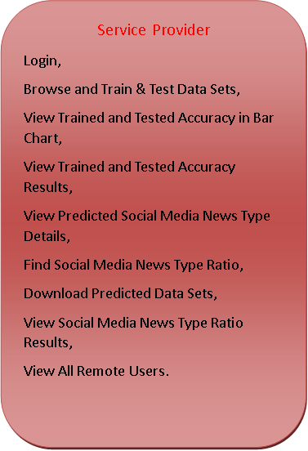

ARCHITECTURE:
Web Server
Accepting all Information
Datasets Results Storage
Process all user queries
Accessing
Data
Store and retrievals
WEB Database
REGISTER AND LOGIN,
PREDICT SOCIAL MEDIA NEWS TYPE,
VIEW YOUR PROFILE.

Slide 12
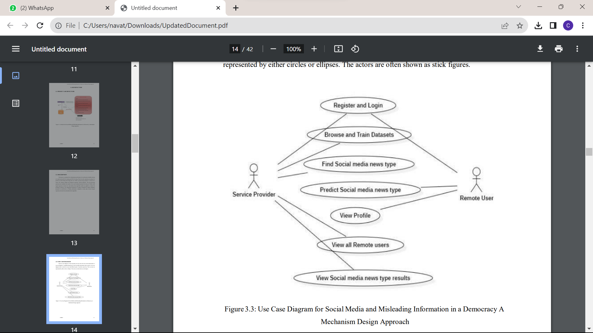
USE CSAE DIAGRAM:

Slide 13
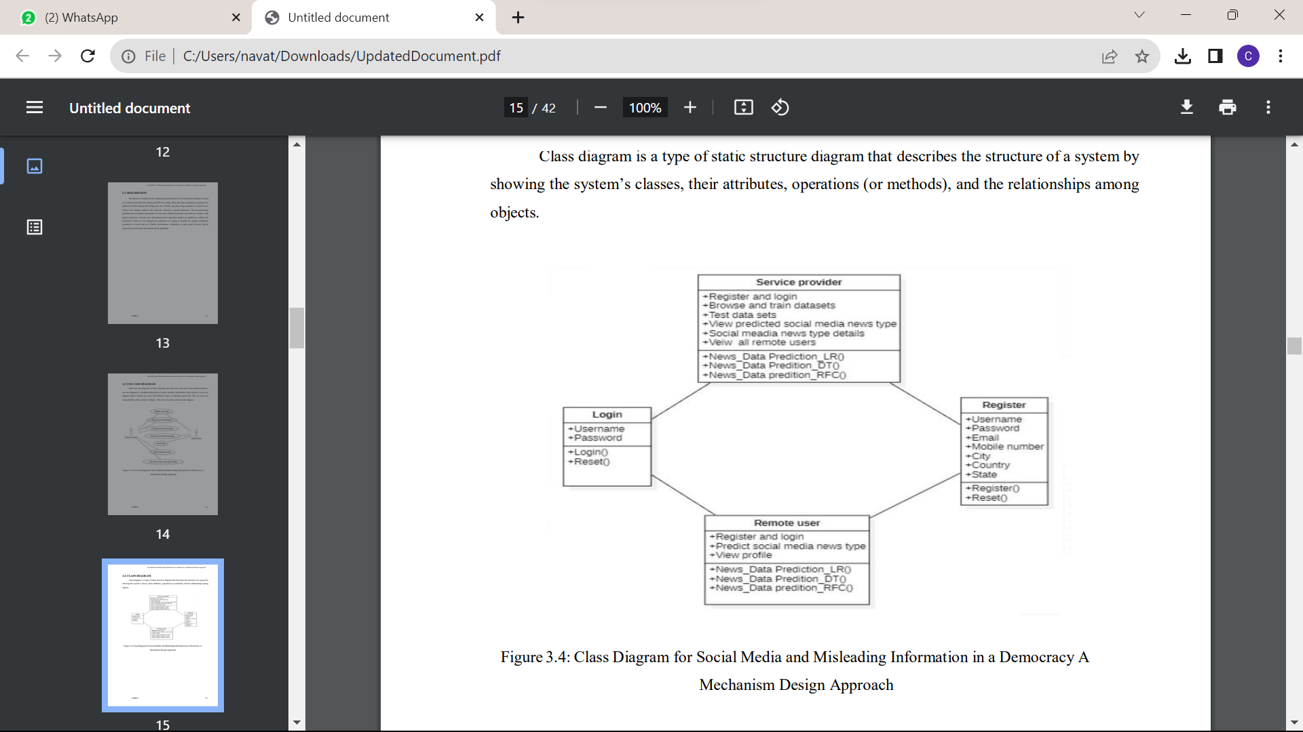
CLASS DIAGRAM:

Slide 14
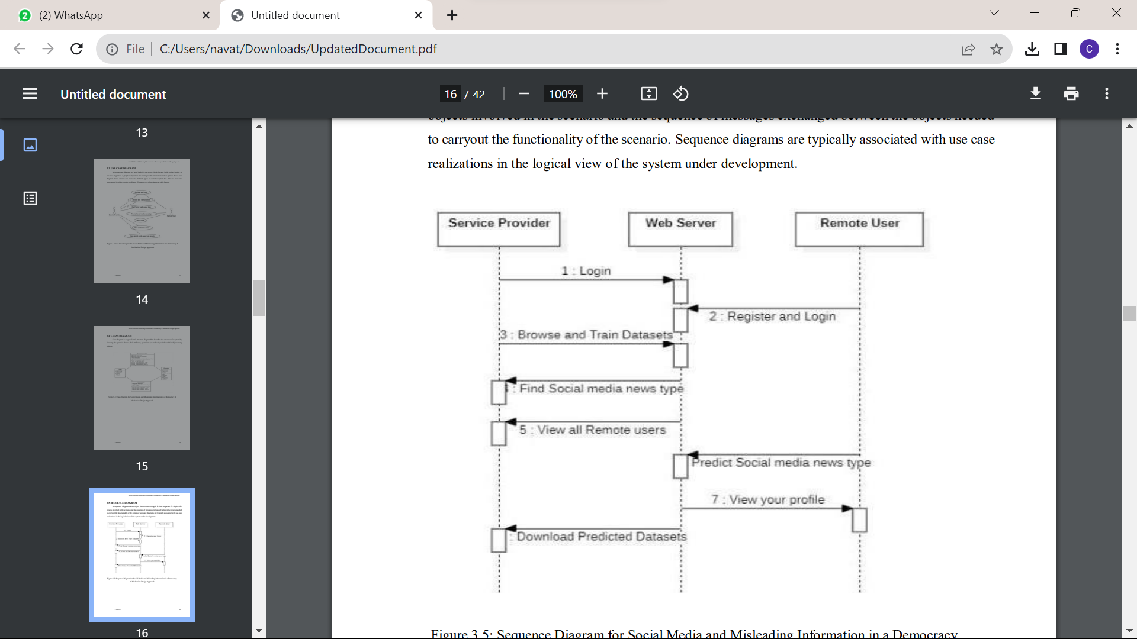
SEQUENCE DIAGRAM:

Slide 15
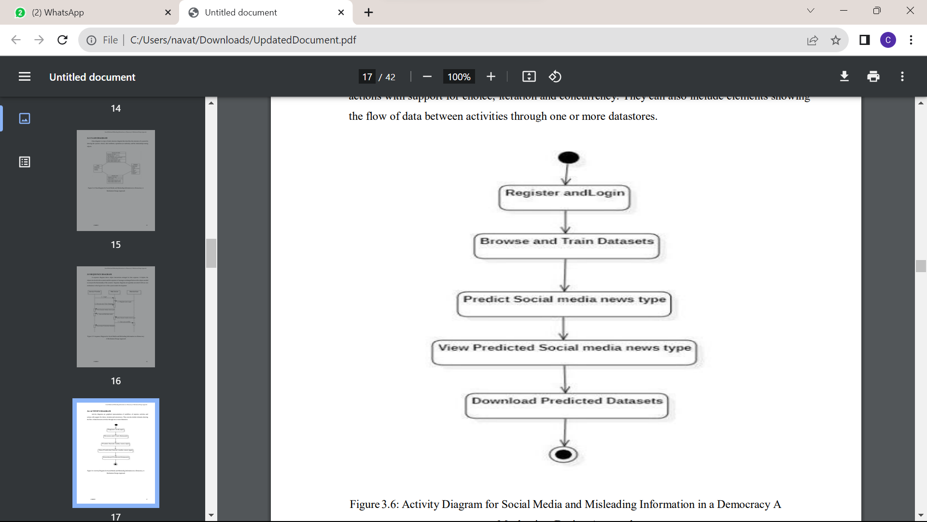
ACTIVITY DIAGRAM:

Slide 16
SAMPLE CODE:
import pandas as pd
import numpy as np
import seaborn as sns
import matplotlib.pyplot as plt
from sklearn.model_selection import train_test_split
from sklearn.metrics import accuracy_score
from sklearn.metrics import classification_report
import re
import string
from sklearn.feature_extraction.text import CountVectorizer
from sklearn.metrics import accuracy_score, confusion_matrix, classification_report
from sklearn.ensemble import VotingClassifier
from Remote_User.models import ClientRegister_Model,Social_Media,detection_ratio,detection_accuracy

Slide 17
df_true_manual_testing = df_true.tail(10)
for i in range(21416, 21406, -1):
df_true.drop([i], axis=0, inplace=True)
df_fake.shape, df_true.shape
df_fake_manual_testing["class"] = 0
df_true_manual_testing["class"] = 1
df_fake_manual_testing.head(10)
df_true_manual_testing.head(10)
df_manual_testing = pd.concat([df_fake_manual_testing, df_true_manual_testing], axis=0)
df_manual_testing.to_csv("manual_testing.csv")
df_merge = pd.concat([df_fake, df_true], axis=0)
df_merge.head(10)
df_merge.columns
df = df_merge.drop(["title", "subject", "date"], axis=1)
df.isnull().sum()
df = df.sample(frac=1)
df.head()
df.reset_index(inplace=True)
df.drop(["index"], axis=1, inplace=True)
df.columns
df.head()

Slide 18
def wordopt(text):
text = text.lower()
text = re.sub('\[.*?\]', '', text)
text = re.sub("\\W", " ", text)
text = re.sub('https?://\S+|www\.\S+', '', text)
text = re.sub('<.*?>+', '', text)
text = re.sub('[%s]' % re.escape(string.punctuation), '', text)
text = re.sub('\n', '', text)
text = re.sub('\w*\d\w*', '', text)
return text
cv = CountVectorizer()
df["text"] = df["text"].apply(wordopt)
x = df["text"]
y = df["class"]
x = cv.fit_transform(x)
x_train, x_test, y_train, y_test = train_test_split(x, y, test_size=0.25)

Slide 19
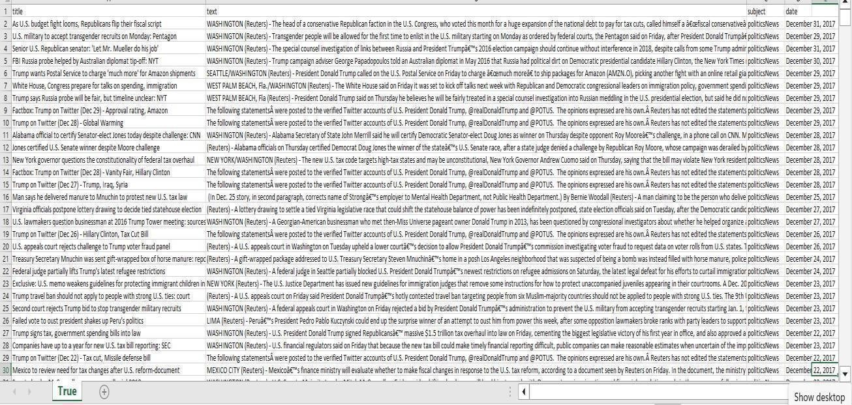
RESULTS:
True Data Set Values

Slide 20
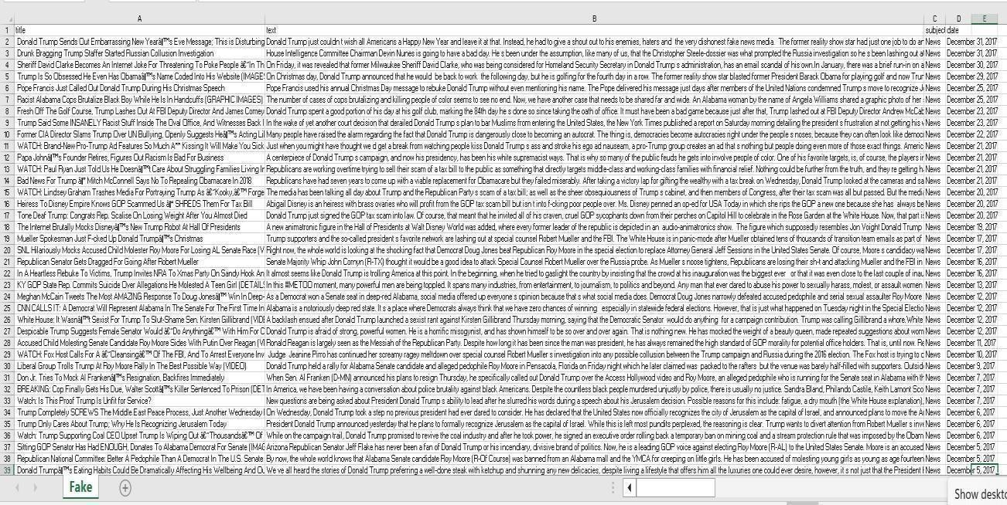
False Data set Values

Slide 21
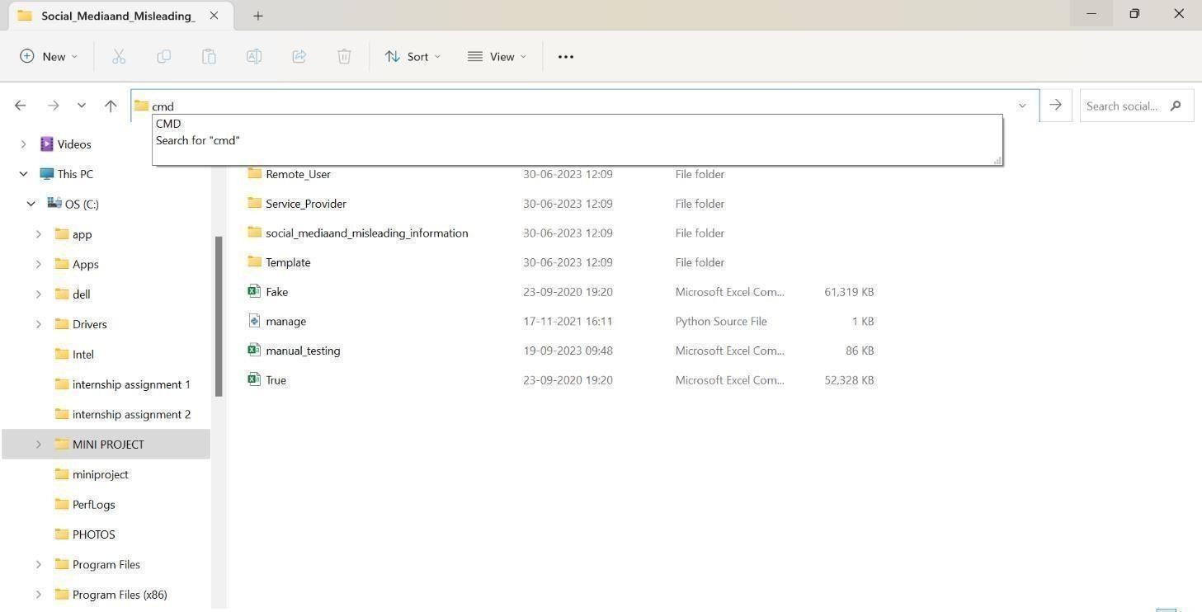
Opening the CMD for running the program

Slide 22
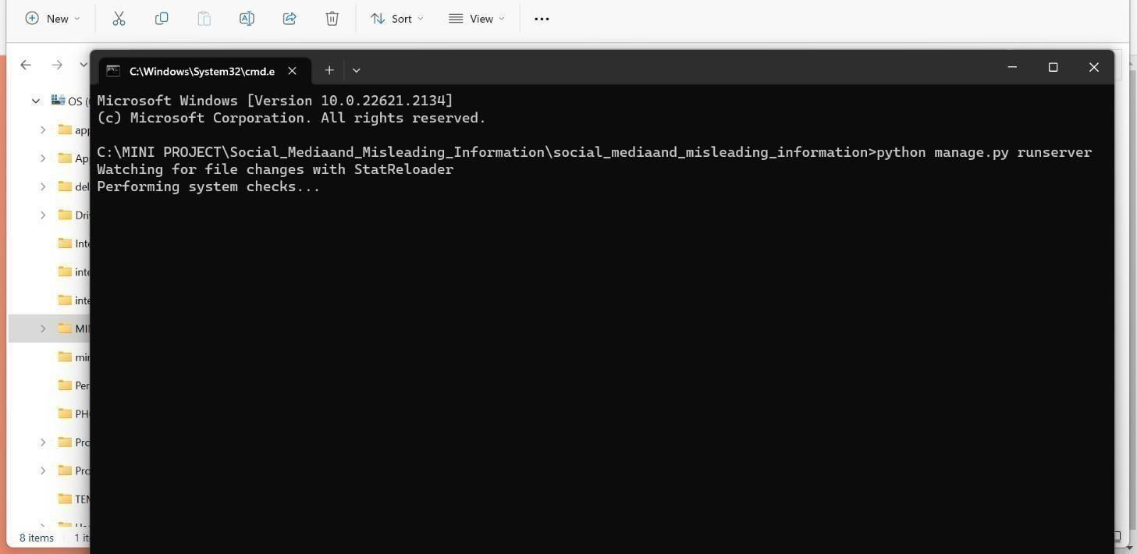
Open the web-page for predicting data

Slide 23
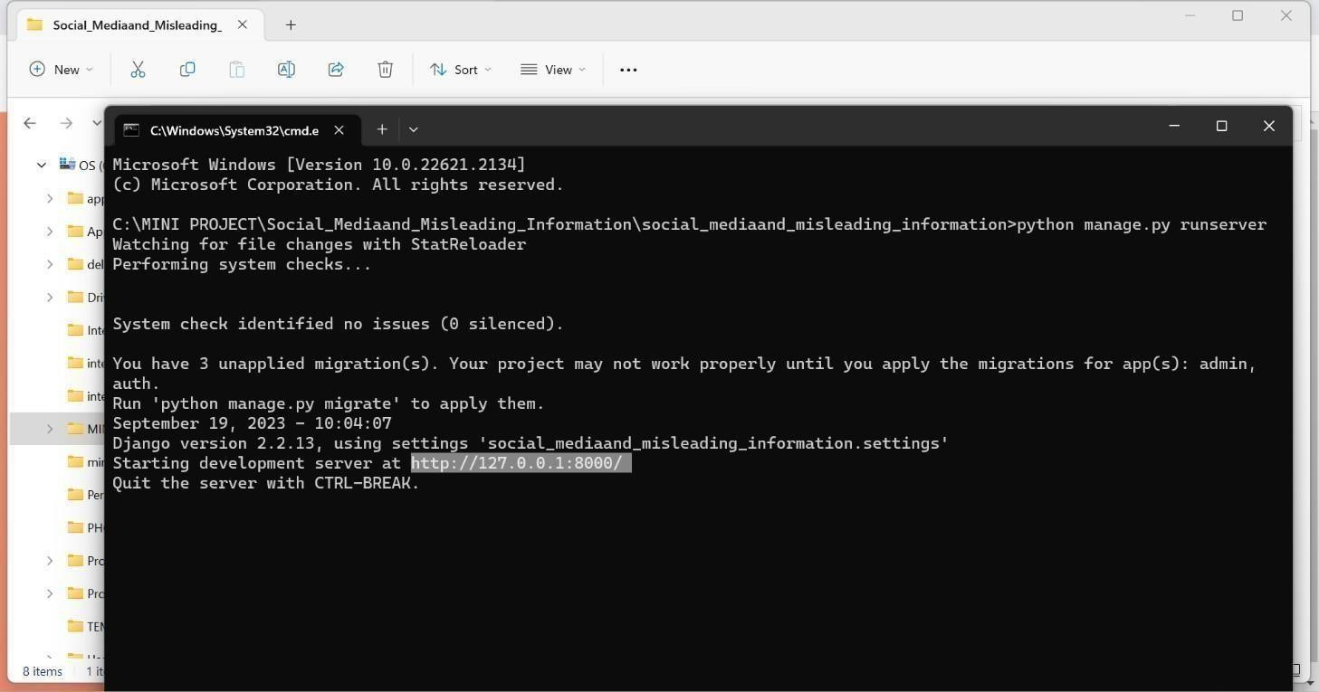
Copy the link of Web-page

Slide 24

Paste the Web-page link in Search engine

Slide 25

After opening the web-page looks like this

Slide 26

Now login as Service Provider

Slide 27
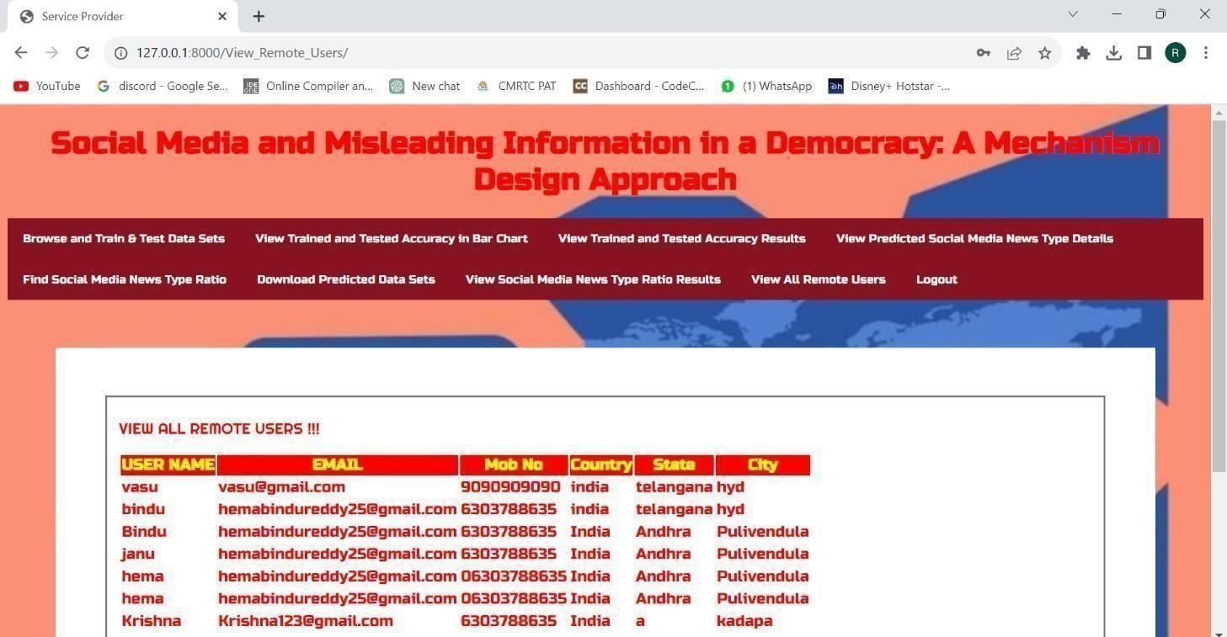
After login the web-page looks like this

Slide 28

Register as Remote-user

Slide 29

Login as Remote-user

Slide 30
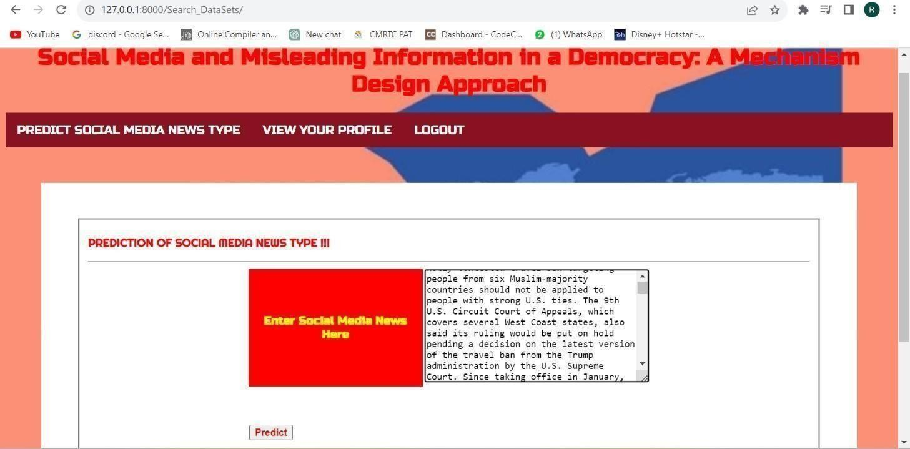
Giving True Data-set values for prediction

Slide 31
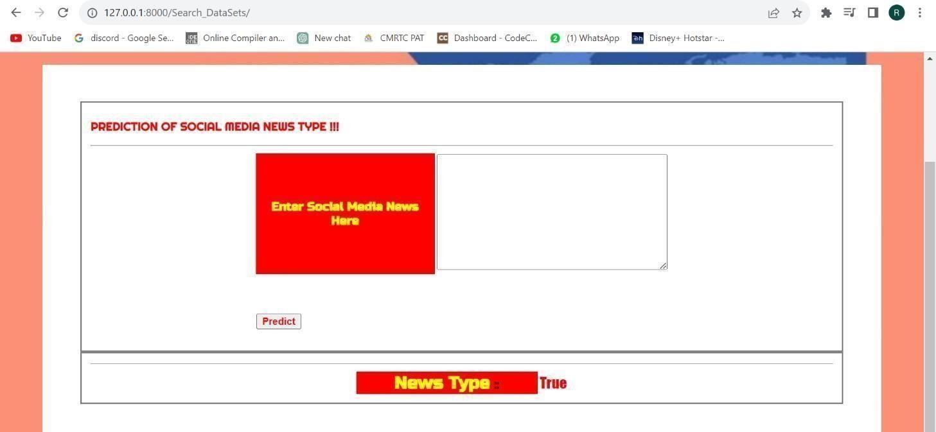
Predicting the news type as True

Slide 32
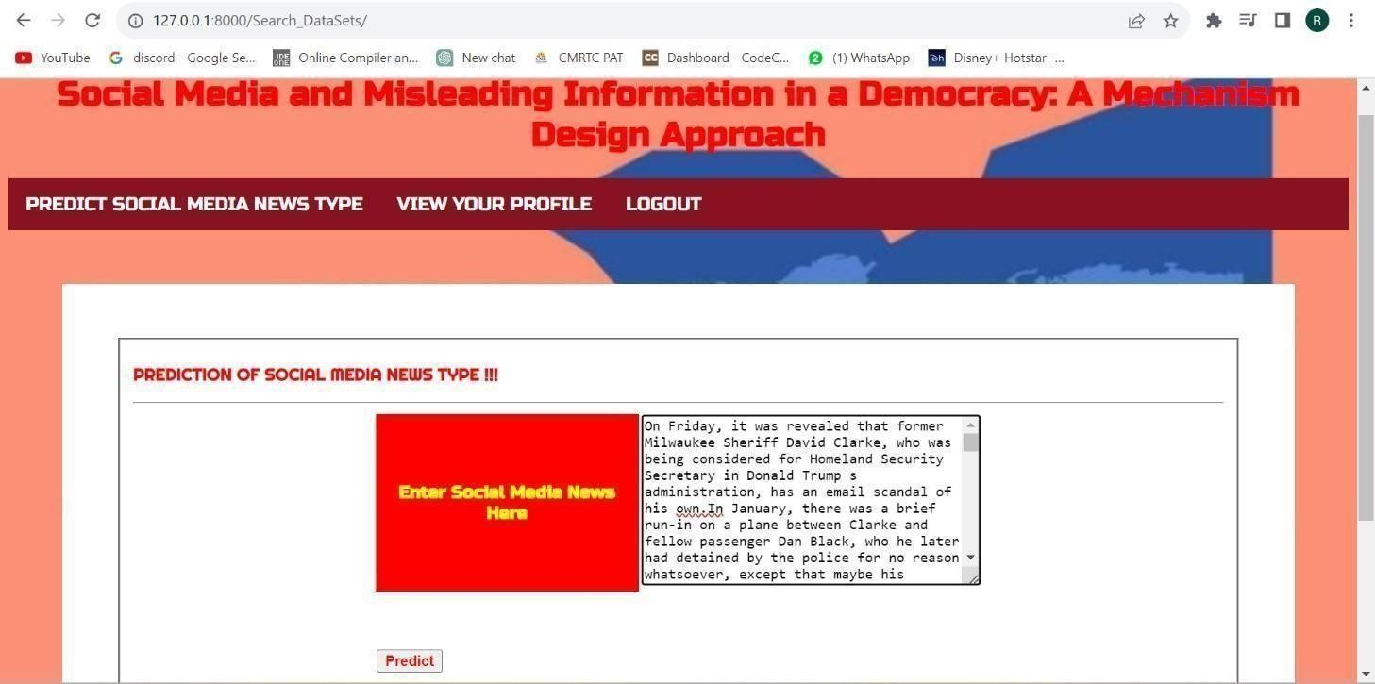
Giving False Data-set values for prediction

Slide 33
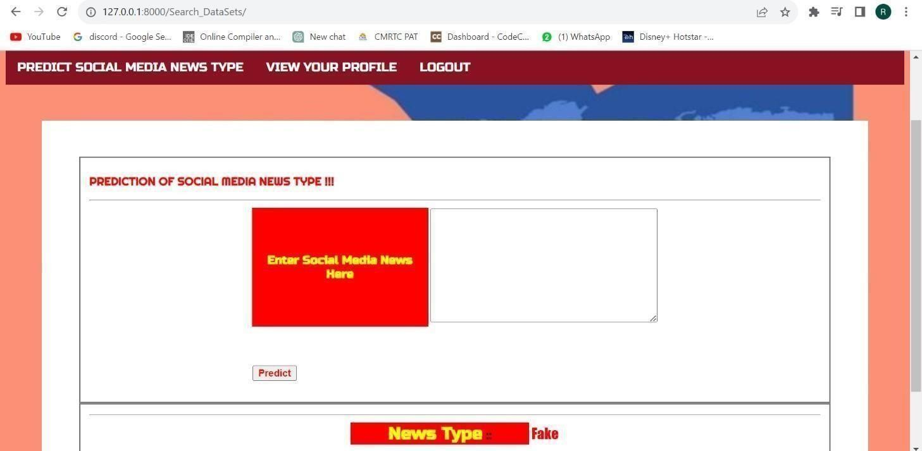
Predicting the news type as False

Slide 34
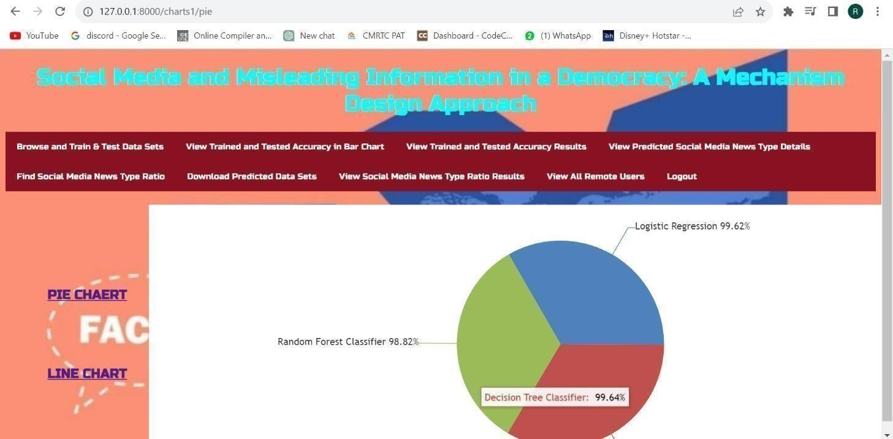
Pie-Chart comparison for algorithms

Slide 35
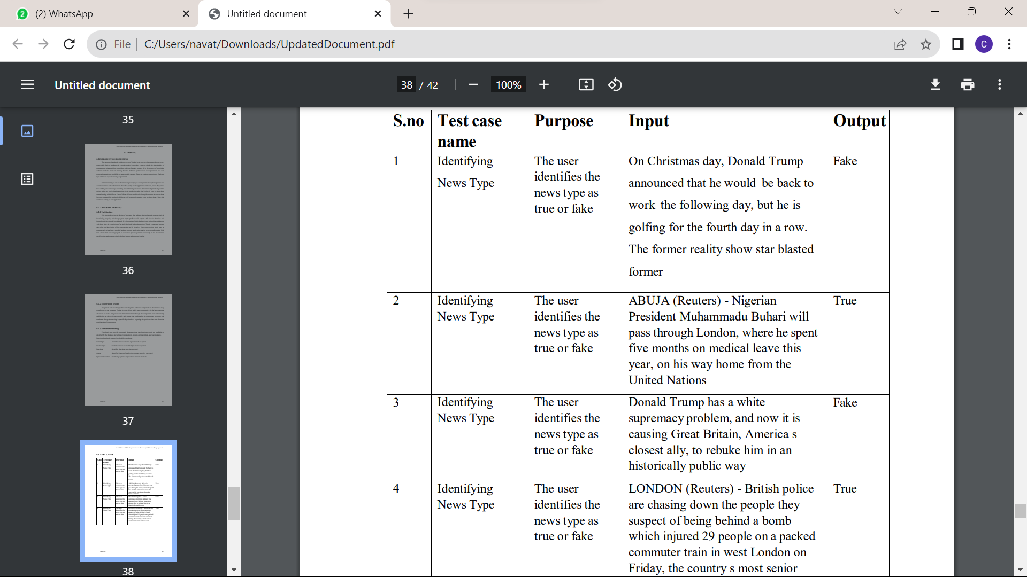
TEST CASES:

Slide 36
FUTURE SCOPE:
Algorithm Transparency
Data Privacy
Cross-Platform Collaboration
Regulatory Frameworks

Slide 37
REFERENCES:
Pennycook, G., & Rand, D. G. (2019). The Implied Truth Effect: Attaching Warnings to a Subset of Fake News Stories Increases Perceived Accuracy of Stories Without Warnings. Management Science, 67(11), 4944-4957.
Guess, A., Nyhan, B., & Reifler, J. (2020). Exposure to untrustworthy websites in the 2016 US election. Nature Human Behaviour

Slide 38
CONCLUSION:
Our primary goal in this paper was to design a mechanism to induce a solution in the misinformation ﬁltering game, where
1. We have designed a mechanism to flter the misleading information from social-media.
2. Spread of fake news is reduced.

Slide 39
THANK YOU!!

